Slide 1
WinCC OA trend widget
https://portal.etm.at
Restricted © Siemens AG 2016

Slide 2
Motivation
Trends are provided for visualizing the changes of data point values
over a specific period of time (value-over-time)
or
for relating changes in different data point values to each other (value-over-value).
It should be possible to display a logarithmic trend, which displays the values on a logarithmic scale instead of a linear scale.

Slide 3
Trend functionality in WinCC OA
The most important functionalities in WinCC OA provided by a trend are:
  Ruler
  Scales
  Legend
  Context menu of the trend
  Further functions

Slide 4
Create a WinCC OA trend

Slide 5
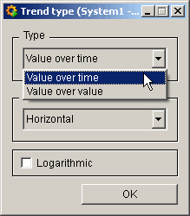
HOW TO CREATE A TREND
Click on the trend object in the WinCC OA GEDI.
Click in the panel work area. Drag the frame to the required size.
The Trend Editor opens and a childpanel appears for specifying the trend type and orientation.
Select the desired trend type and click on OK.
Enter a data point as the data source.

Slide 6
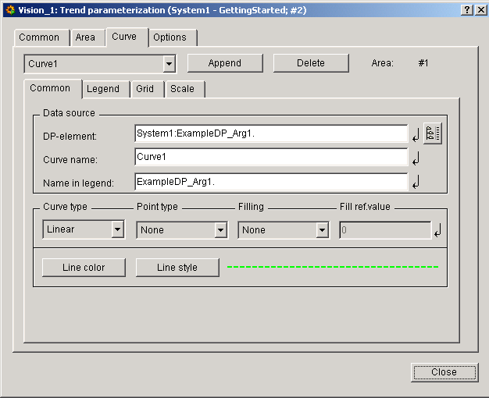
Curve - Common tab
The general setting of the curve will be done here.
Notes:
Enter a curve name in the Common tab of the trend curve. It must be unique and should characterize the curve. Press the enter key to apply the curve name. The new curve name is updated in the combo box above the curve tabs after closing and reopening the trend editor.
Enter the legend label for the curve. This is the name of the curve as it will appear in the legend of the trend.

Slide 7
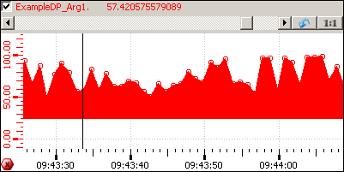
Curve - Common tab - filling
Notes:
Filling
The area beneath the curve can be filled with the line color. The fill can be related to a reference value.
Fill ref.value
Enter here the reference value to which the curve fill relates.

Slide 8
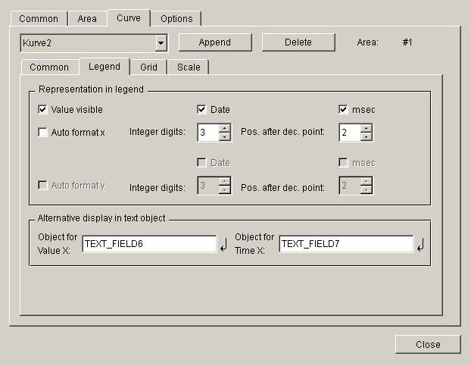
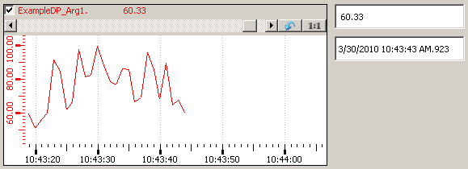
Curve - Legend tab
Notes:
Click on the Value visible option to display the current value of the data point element in the trend legend..
Disable the Auto format x checkbox to define further details for display relating the x axis in the legend (see above).
Define the integer digits and the positions after decimal point the value can have to be displayed in the legend.
Select Date and msec. This means that date and the milliseconds will be shown in the legend.
Note that the trend shows the offline value.

Slide 9
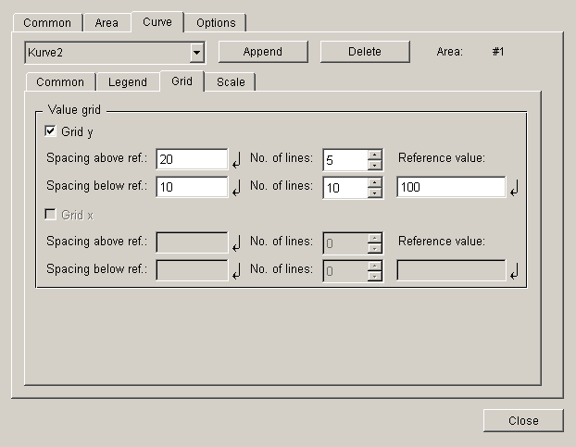
Curve – Grid tab
Notes:
With the aid of the reference value a line on the y axis between the above and below grid lines is defined. This means that if e.g. the reference point is 100 and 5 grid lines with a spacing of 20 were defined above the reference value, then horizontal grid lines are displayed at the values 120, 140, 160, 180 and 200 of the Y axis of the trend.
Note that the reference value has to be bigger than 0 if you have chosen the trend type value-over-time, horizontal and logarithmic.

Slide 10
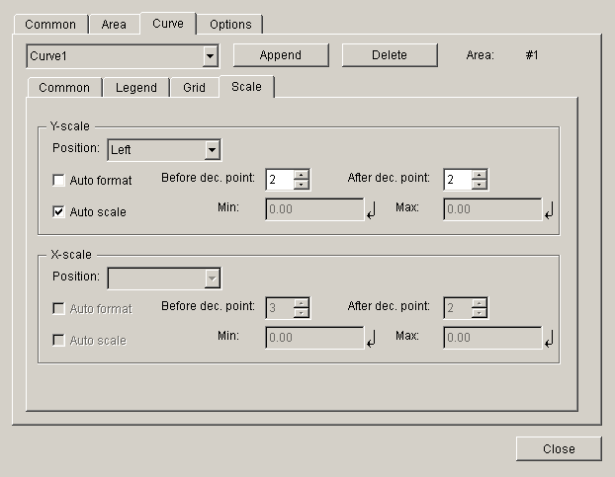
Curve – Scale tab
Notes:
Note that logarithmic scales are possible on the X and Y axis.
If the Auto format is not enabled for the Y-scale , it is only possible to edit position after decimal points and the format to be set has to be exponential in case of the trend type value-over-time, orientation horizontal and logarithmic. Note that the minimum and maximum values per curve have to bigger than 0 for a logarithmic trend.
Auto scale Min. Max.: here you can define the maximum and minimum values of your y-axis.

Slide 11
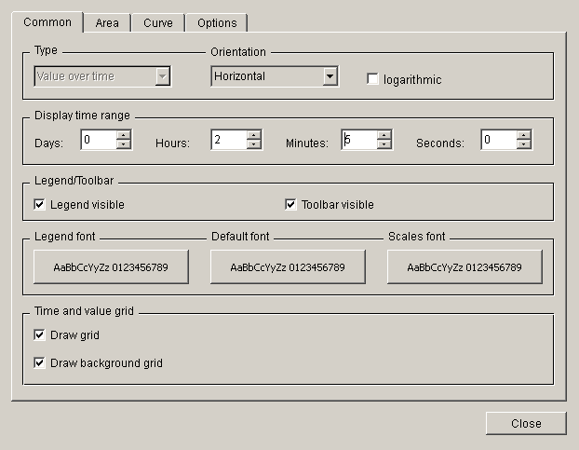
Common
The general setting of the trend will be done here.
Notes:
Display time range
Note that if you do not want e.g. hours (days, minutes or seconds) to be displayed you have to enter a zero (not a blank) into the specific field.
Draw grid checkbox to display vertical grid lines in foreground or background

Slide 12
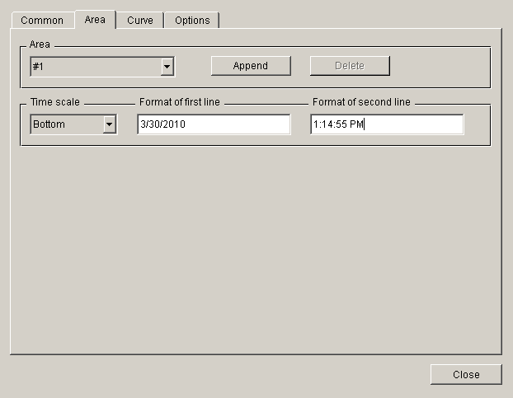
Area
Additional trend areas can be added here.

Slide 13
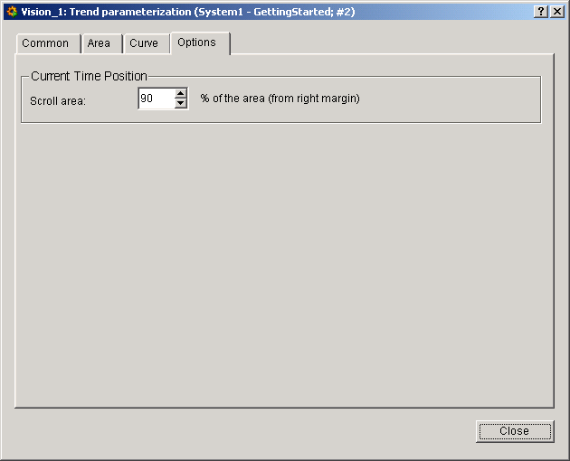
Options
Configuration of time leaps (only for value-over-time trend) and zoom can be done here.
Notes:
The curve is always reset when its last point reaches the right-hand edge of the element. A leap of 99 percent for example results in the curve being constantly displayed. The size of the leap is selected by clicking on one of the spin button arrow heads.

Slide 14
WinCC OA trend functionalities of Rulers

Slide 15
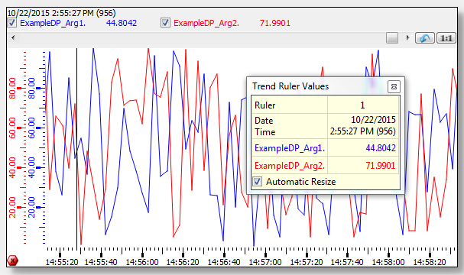
Functionality of Ruler
A ruler can activated and deactivated using the left mouse button.
If the ruler is positioned, the automatic refresh to now-time is deactivated.
The view will be frozen at this time the ruler has been set.
The trend run will not be stopped, just the view will be frozen - thus zooming and other functions are allowed.
If the ruler will be deactivated, the current view persists. If the update of the trend view is stopped, an icon is shown in the bottom left corner of the trend.

Slide 16
Functionality of Differential Ruler
Press the left mouse button + Shift key to set a differential ruler in addition to the already first set ruler.
The popup window shows the following data:
  Start date and time of the historical first ruler
  End date and time of the historical second ruler
  Difference between start and end
  Curve values of the ruler position and the differential ruler position
  Value difference between the curve values of both rulers

Slide 17
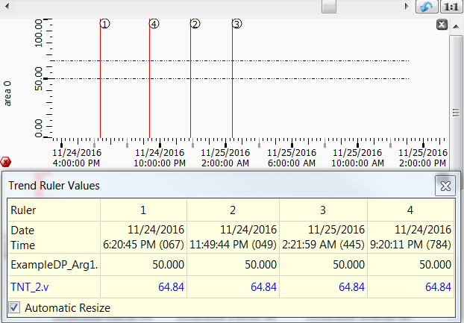
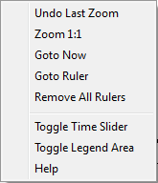
Functionality of Rulers
The ”maxRulerCount” attribute allows to use several rulers in a trend area.
The rulers are distinguished by numbers.
The values of the additional rulers will be added to the "trend ruler values" popup window.
Notes:
The differential ruler can be displayed with the left mouse button and the shift key as usual. The difference is calculated between the first ruler and the differential ruler.
The middle mouse button can not be used in case of several rulers.
The rulers can be removed altogether with the "remove all rulers" entry in the context menu or individually by a left mouse click on the particular ruler. If you press the left mouse button, you can draw the ruler to another position. Note that by using the option "Remove All Rulers, both vertical and horizontal reference lines are removed.

Slide 18
Functionality to set a Ruler at an exact time
rulerTime/s
The attribute "rulerTime/s" returns or sets the times for a ruler/for more than one ruler of a trend.
Example to set one ruler at current time:
  time t = getCurrentTime();
  TREND1.trendStop();
  TREND1.rulerTime(0, t);

Slide 19
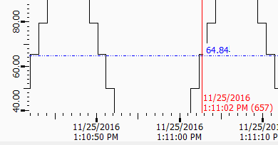
Functionality of Value-Axis Ruler
It is also possible to set rulers for the value axis (trendEnableCurveRulers = 1 in [ui] section).
Clicking directly on the value axis or Shift + Click on the trend curve add a new value axis ruler.
If the mouse cursor is pointed on an intersection between a value axis ruler
and a curve the next curve value to this intersection point can be displayed.
Clicking directly on the ruler will remove the value axis ruler.
The color of the ruler matches the curve color for which the ruler has been set.
The line type value axis ruler is always displayed as dotted line.

Slide 20
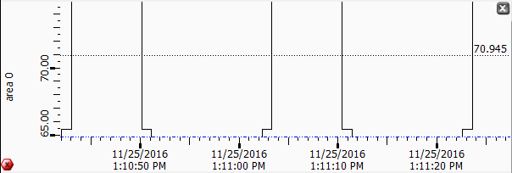
Functionality of Value-Axis Ruler
Display or hide the accurate value for a vertical ruler of a trend curve
With the trend attribute "curveRulerLabelVisibility" or "curveRulerLabelVisibilityX" you can display or hide the accurate value for a vertical ruler of a trend curve.
The accurate value is also shown when you move the ruler even if you do not use these functions.

Slide 21
Functionality of Value-Axis Ruler
Snapping mode for vertical ruler
With the trend attribute “curveRulerSnapValue" you can activate the snapping mode (on/off) for the Y-axis for the horizontal ruler of a trend while moving it up/down.

Slide 22
WinCC OA trend functionalities of Areas

Slide 23
Functionalities of Areas
The attribute "addTrendArea" adds a new trend area to the trend.
The attribute "removeTrendArea" deletes a trend area.
The attribute "areaFixed" you can fix a trend area.
The attribute "linkAreas" you can link two trend areas and with the attribute "unlinkAreas" you can unlink them.
The attribute "areasClosable" you can close all trend areas and with the trend attribute "areaClosable" a specific trend area.
The attribute "areaMinimumSize" you can set the minimal size for a trend area.
The attribute "areasMinimumSize" you can set the minimal size of all trend areas to the same size.
The attribute "areasCollapsible" the size of a trend area can be set to 0 although the minimum size was set.

Slide 24
WinCC OA trend functionalities of Scales

Slide 25
Functionalities of Scales
The trend has two scales - the vertical value scale of each curve and a shared horizontal time scale.
The value scales are shown in the corresponding colors of the curves. Red tick marks show the beginning of a month on the time scale. Gray tick marks indicate that the whole text cannot be shown on the time scale (the text is too long/big).
Both scales can be moved by a mouse-click - hold left mouse-button pressed and move, then release.
The same effect you achieve by holding the scrolling wheel + Shift key pressed.
To zoom/move the time scales of several trend areas collective, the function "visibleTimeRange" can be used.
Notes:
When scrolling the trend, the database request will be delayed by 0.5 seconds. If you continue scrolling during this timeout, the timer will be restarted. The request will be done, when no scrolling process will be performed for 0.5 seconds.

Slide 26
WinCC OA trend functionalities of Legend

Slide 27
Functionalities of Legend
The trend legend shows the names of the data point elements in the corresponding colors of the curves.
The current value/time or the ruler value/time of each curve is shown.
Use the "Toggle Date-Time and Value Display" option from the legend context menu to hide the date and time display.
The shown curves can be hidden/shown in any combinations. Therefore tick the specific checkbox of a curve in the legend or remove the tick from a combo-box, respectively.

Slide 28
WinCC OA trend functionalities of Zoom

Slide 29
Functionalities of Zoom
It is possible to zoom in a defined trend range using the mouse.
Press the left mouse button, select the area you want to zoom and drag the appearing rectangle bigger or smaller in order to activate the zooming functionality.
If the mouse pointer is only moved within the horizontal and vertical border, you can only zoom in one direction.
You can also zoom with the scrolling mouse wheel.
Zooming with mouse Wheel
With the trend attribute "mouseWhellZoomsValue" you can deactivate the zooming with the mouse wheel for the value axis of a trend.

Slide 30
WinCC OA trend functionalities of Context menu

Slide 31
Functionalities of Context menu
The following options are available in the trend context menu (right-click on the trend):
  "Undo last zoom" - undoes the last zoom operation.
  "Zoom 1:1" - reconstructs the original size of the trend.
  "Goto Now" - jumps to Now in the time display.
  "Goto Ruler" - jumps to the ruler in the time display.
  "Toggle Time Slider" - hides or shows the time slider.
  "Toggle Legend Area" - hides or shows the legend area.
  "Help" - opens the Online Help.

Slide 32
WinCC OA trend further functionalities

Slide 33
Further functionalities
Using CTRL key and left mouse button, you can drag trend curves within the trend (panning).
If the invalid bit is set for a data point, the trend curve is shown with a pink marker and dotted line. Filled curves are shown using cross-hatch. How an invalid range will be shown will be specified by the config entries trendInvalidColor, trendInvalidLineType and trendInvalidFillType.
In case of a disconnection of the DIST managers in a distributed system, the trend legend will be shown the "disconnect" icon. Additionally the curve changes to dotted purple and the time of the disconnect is stamped by a purple dot.
When using the AutoScale function, no scaling will be performed while the Trend is stopped or when values only changes outside of the visible range. The automatic scaling will be continued when the trend has been restarted. If the ruler is moved from the view of past values to the current time, no automatic scaling will be performed. To start the automatic scaling again it is necessary to stop and start the trend.

Slide 34
WinCC OA trend behavior at redundancy switchover

Slide 35
WinCC OA trend behavior at redundancy switchover
In case of a redundancy switchover a gap between the displayed values may occur.
To prevent this issue a refresh of the trend widget is required after the switchover. The refresh must planned as part of the project.
An increased load caused by simultaneous value queries must be considered when using a high number of trend widgets.

Slide 36
WinCC OA trend some other trend attributes

Slide 37
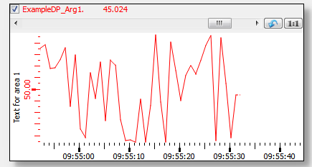
areaLabel
The new trend attribute "areaLabel" can be used to define a text that is shown horizontally on the left or vertically above the scale.

Slide 38
curveRulerLabelVisibility
With the trend attribute "curveRulerLabelVisibility" or "curveRulerLabelVisibilityX" you can display or hide the accurate value for a vertical ruler of a trend curve.
The accurate value is also shown when you move the ruler even if you do not use these functions. Note that this only applies to a ruler that is moved.

Slide 39
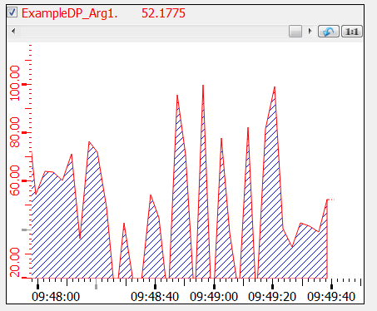
curveFillColor and curveFillType
The attribute "curveFillColor" sets the color of a trend curve together with the fill type of a curve via the attribute "curveFillType".

Slide 40
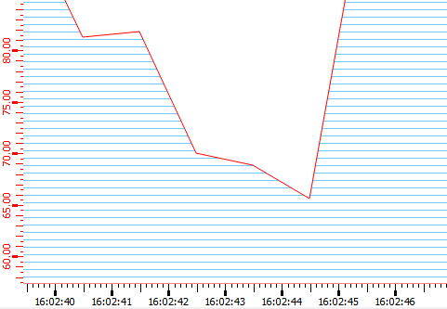
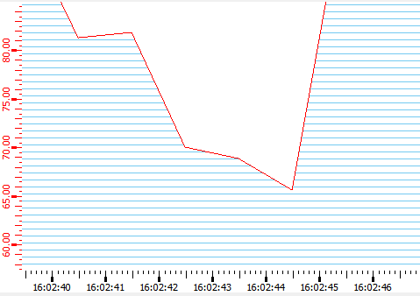
autoAntiAlias
The trend attribute "autoAntiAlias" can be used to display the trend more accurately.
with antialiasing
without antialiasing

